Slide 1
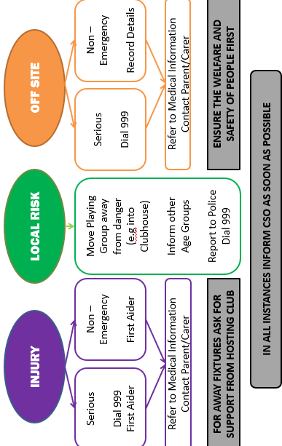

EMERGENCY PLAN
KEY INFORMATION
BASC Postcode: TA8 2BS
EMERGENCIES: 999
CSO: 07811 167108
RSL: 07812 355373
FIRST AIDERS:
Barry New
(Clubhouse/Kitchen)
Glenn Cutter
(Senior Training/Match)
Amy Barton
Nathan Mead
Adam Rose
Emma 0’Regan
David Barton
Lee Berry
Stephen Hall
Scott Mills
DEFIBRILLATORS: CLUBHOUSE BOTTOM OF METAL STAIRS
ADDITIONAL FIRST AID KIT: CLUBHOUSE BAR/HOME CHANGING ROOM
TELEPHONE: CLUBHOUSE BAR
MINOR INJURIES UNIT:
01278 773100
6 LOVE LANE
BURNHAM-ON-SEA
SOMERSET
TA8 1ED
A&E:
MUSGROVE HOSPITAL
PARKFIELD DRIVE TAUNTON SOMERSET TA1 5DA
CONTACTS:
CHAIRPERSON -
Lee Berry: 07989 320830
VICE CHAIRPERSON -
Emma O’Regan: 07812 355373
RUGBYSAFE LEADS -
Emma O’Regan: 07812 355373
Stephen Hall: 07851 689074
CLUB SAFEGUARDING OFFICER -
Tim James: 07811 167108

Slide 2
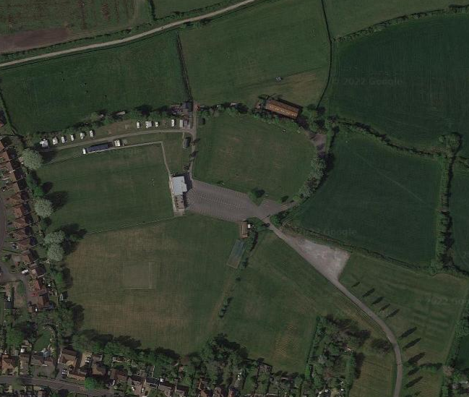
Pitch Access =
W3W = what 3 words location
Back Pitch
W3W: ideals.depended.defaults
Main Pitch
W3W: couple.torn.tinny
Training Pitch
W3W: signs.strategy.latter
Junior Pitches
W3W: newsreel.loser.inkjet
Clubhouse
W3W: peroxide.graphic.topples
Postcode: TA8 2DX
Mini Pitches
W3W: thighs.canton.artichoke
Outside Pitch
W3W: register.diverting.keep
Entrance Gate
W3W: closes.roadshow.refuse
Postcode: TA8 2EL

